Slide 1
Fluid Mechanics Class Note
Dr. Qassem Hamed Jalut Associate Professor
Lecture Note
Fluid Mechanics
(part-I)
Dr. Qassem Hamed Jalut Associate Professor
University of Diyala College of Engineering
Department of Civil Engineering

Slide 2
Fluid Mechanics Class Note
Dr. Qassem Hamed Jalut Associate Professor
Course Content
Ch1. Fluid properties
Ch2. Fluid Statics
Ch3. Fluid Flow Concepts and Equations
Ch4. Viscous Effects and Flow Resistances
Ch5. Compressible Flow
Ch6. Ideal Fluid Flow
Ch7. Flow in Closed Conduits and Open Channels
Text Book: Fluid Mechanics by Donald F. Young and others (1997)
Reference Books
1. Fluid Mechanics with Engineering application by Robert L. Daugherty and others. (1989)
2. Fluid Mechanics for Civil Engineers by Webber.
3. Fluid Mechanics by Streeter
Exams: First Term Exam+ Term paper : 10% Mid Term Exam:20% Second Term Exam + Term paper : 10 % Final Exam: 50 % Laboratory : 10 %

Slide 3
Fluid Mechanics Class Note
Dr. Qassem Hamed Jalut Associate Professor
Terminology
Variable
Symbol
p Roh
unit
ريغتملا
Density
Kg/m³
ةفاثكلا
Specific Wieght
ɤ Gamma
N/m³
For water=9.81 N/m³
يعونلا نزولا
Specific gravity
s.g
dimensionless
ةيبسنلا ةفاثكلا
Viscosity
µ
mu
N.s/m²
ةجوزللا
Shear stress
Ţ
Tao
N/m2
صقلا دهج
Surface tension
σ segmma
N/m
يحطسلا دشلا
Force
F
N
ةوقلا
Pressure
P
N/m²
طغضلا
velocity
V
m/sec
ةعرسلا
Discharge
Q
M³/sec
فيرصتلا
Acceleration
a
m/s²
ليجعتلا
Gravity Acceleration
g
m/s²
(9.81)
يضرلاا ليجعتلا
Work
W
N.m
لغشلا
Power
Po
N.m/s
ةقاطلا
Torque
T
N.m
يللا مزع

Slide 4
Fluid Mechanics Class Note
Dr. Qassem Hamed Jalut Associate Professor
Fluid properties

Slide 5
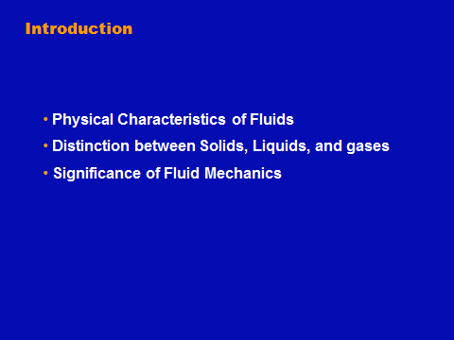
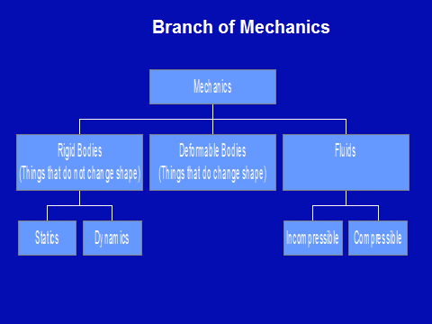
Fluid Mechanics Class Note
Dr. Qassem Hamed Jalut Associate Professor

Slide 6
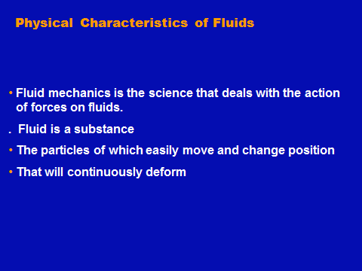
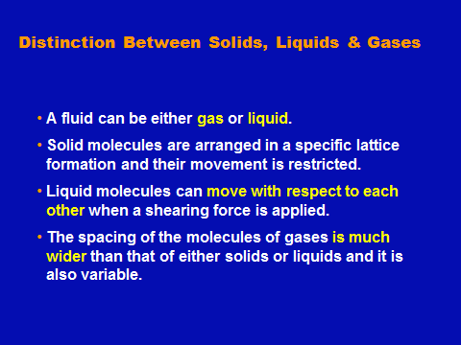
Fluid Mechanics Class Note
Dr. Qassem Hamed Jalut Associate Professor

